Slide 1
PPt 4
Conditional blocks,loops,Loop manipulation,
List and dictionary comprehension

Slide 2
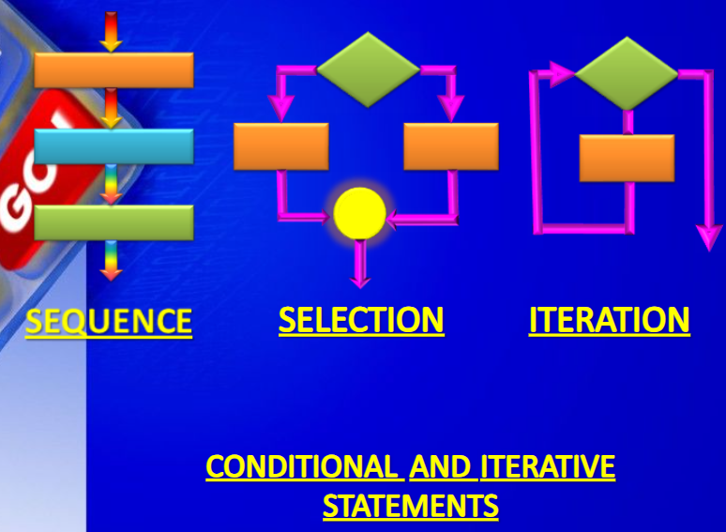

Slide 3
Decision making is an essential concept in any programming language and is required when you want to execute code when a specific condition is satisfied. In this blog, you will learn about the famous if-else statement in Python

Slide 4
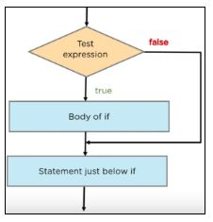
Conditional Block using IF
It involves decision making. If given condition is True, a decision is made to run one block of program. If the decision is false, some other block of code is executed.
First, the test expression is checked. If the expression is true, the body of the if the statement is executed. If it is false, the statement present after the if statement is executed. In either case, any line of code present outside if the statement is evaluated by default.

Slide 5
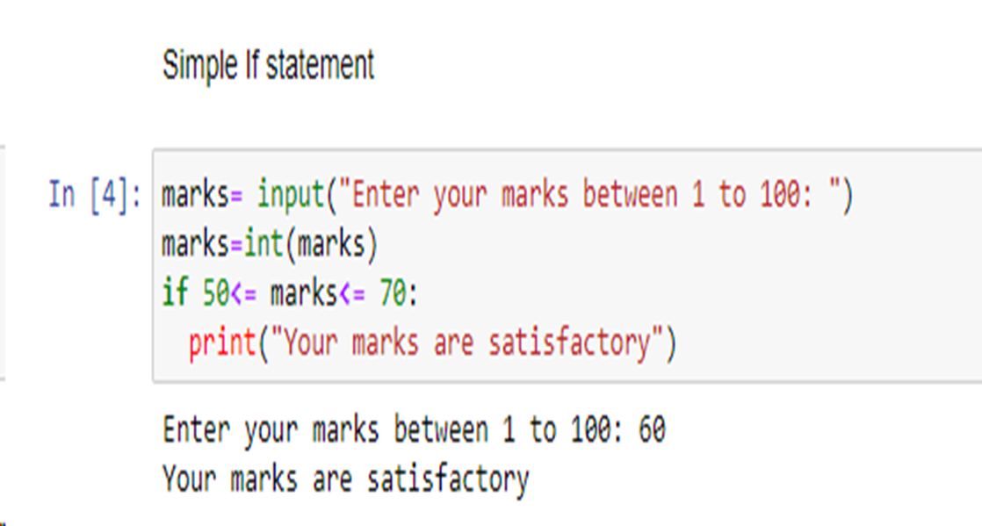

Slide 6
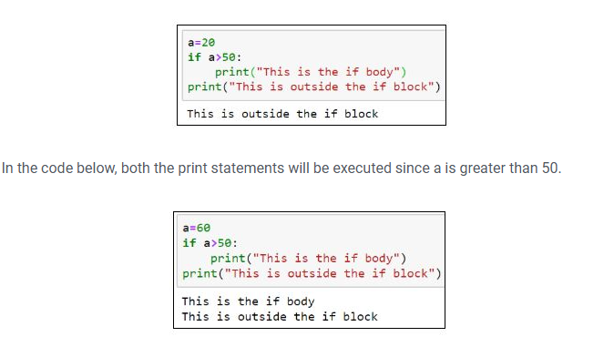

Slide 7
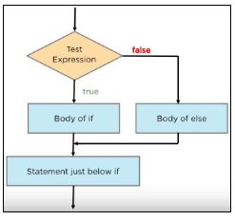
If-Else Statement
The if-else statement is used to execute both the true part and the false part of a given condition.
If the condition is true, the if block code is executed and if the condition is false, the else block code is executed.
First, the test expression is checked. If it is true, the statements present in the body of the if block will execute. Next, the statements present below the if block is executed. In case the test expression has false results, the statements present in the else body are executed, and then the statements below the if-else are executed.

Slide 8
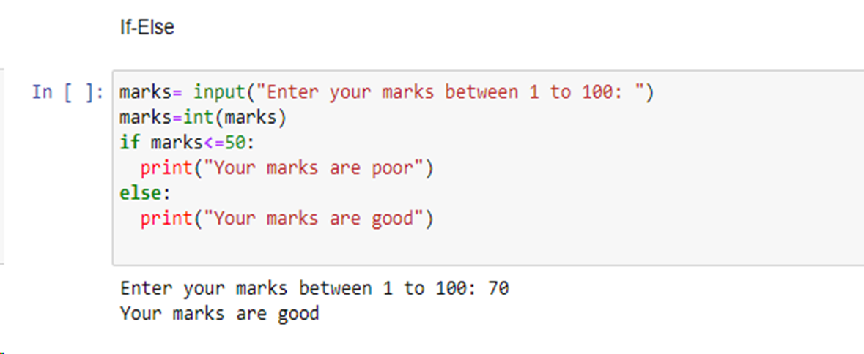
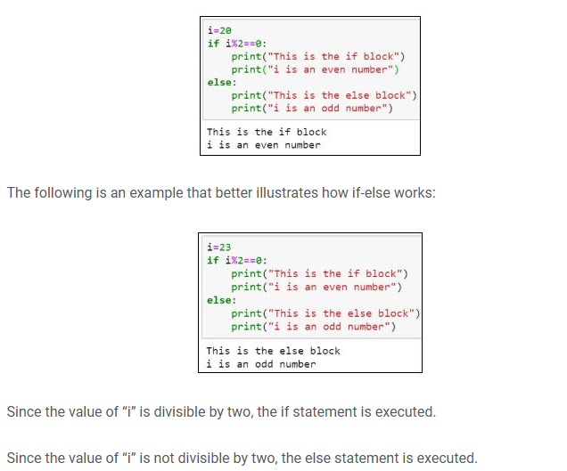

Slide 9
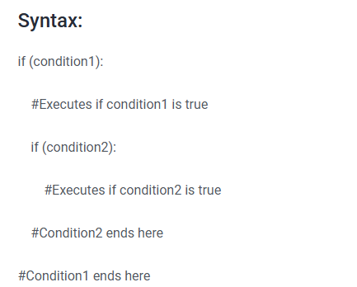
Nested IF Statement
When an if a statement is present inside another if statement, it is called a nested IF statement. This situation occurs when you have to filter a variable multiple times.

Slide 10
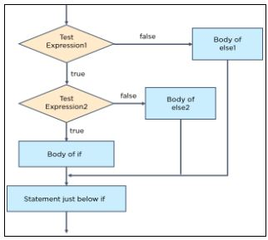
In nested IF statements, you should always take care of the indentation to define the scope of each statement.
You can have as many levels of nesting as required, but it makes the program less optimized, and as a result, can be more complex to read and understand. Therefore, you should always try to minimize the use of nested IF statements.

Slide 11
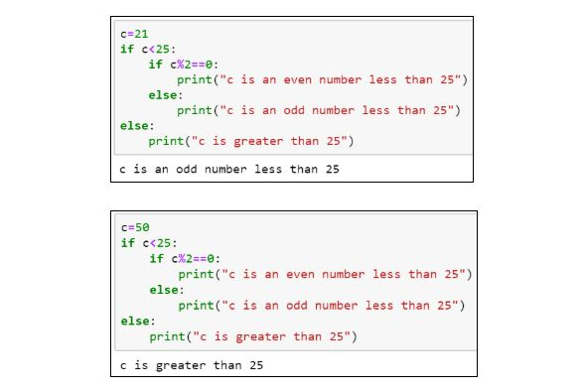

Slide 12
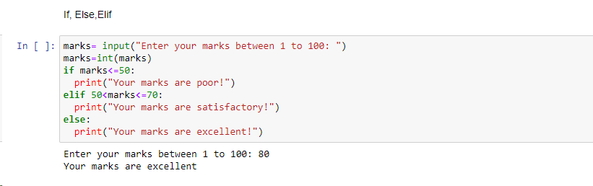
If-Elif-Else Statement
So far, with IF and if-else, we have only seen a binary approach. Suppose we have a problem that has multiple conditions. In this scenario, the if-elif-else statement comes to the rescue.

Slide 13
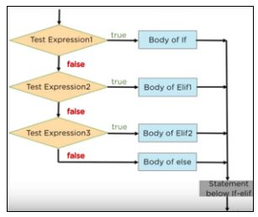
a flowchart that shows how the if-elif-else ladder works.
The Test Expression1 is checked. If that proves true, the body of if is evaluated.
If it is false, then the control moves to the proceeding Test Expression2.
If it’s true, the body of elif1 is executed.
If it’s false, the test expression3 is checked.
If true, the body of elif2 is executed.
If it is false, the body of else is evaluated. Any statement below in if-elif is then checked.

Slide 14
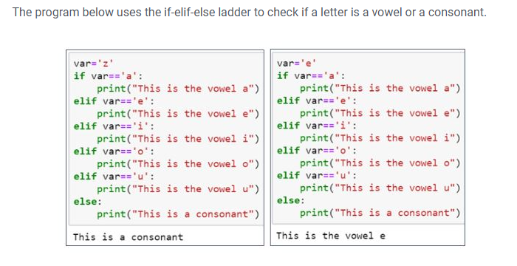

Slide 15
LOOPS
There are two basic loops in python- For Loop While Loop

Slide 16
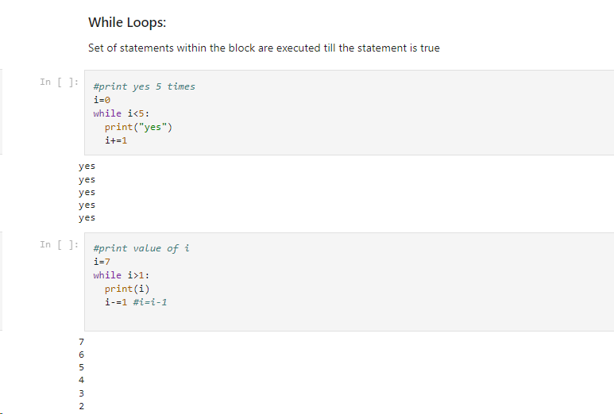

Slide 17
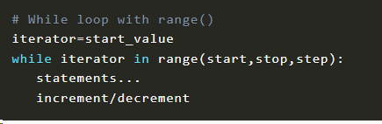
range() in while loop
The range() function is typically used with a while loop to repeat a block of code for all values within a range.
The range function generates a sequence of numbers, starting from 0 by default, and increments by 1 (also by default), and stops before a specified number.

Slide 18
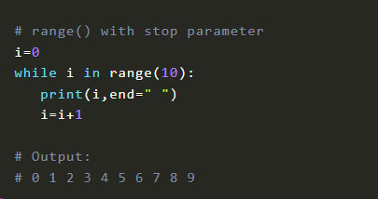
Let’s specify only the stop parameter in the range() function.
Here, we specified stop as 10. So it will return the values starting from 0 to 9.

Slide 19
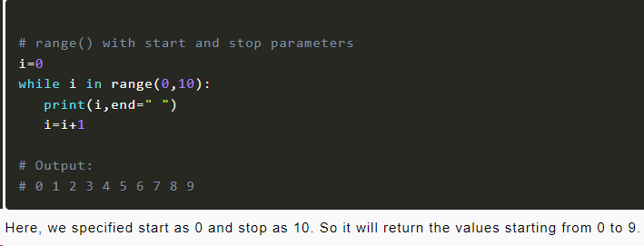
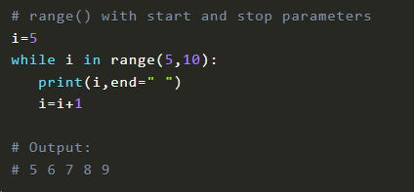
Let’s specify start and stop parameters in the range() function.
Here, we specified start as 5 and stop as 10. So it will return the values starting from 5 to 9.

Slide 20
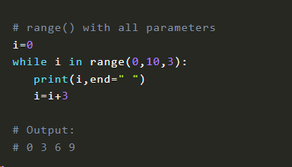
Here, we specified start as 0, stop as 10 and step as 3. So it will return the values starting from 0 to 9 with an increment of 3.

Slide 21
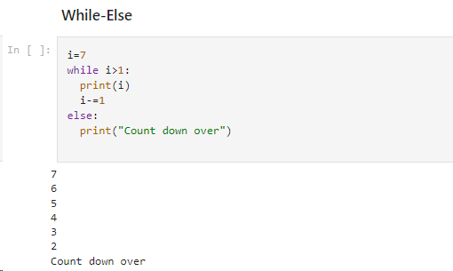

Slide 22
Loop manipulation using Pass, Continue, Break
Using for loops and while loops in Python allows you to automate and efficiently repeat tasks. These loops are fundamental constructs in Python that enable you to iterate over sequences, such as lists, tuples, and strings, or to execute a block of code repeatedly based on a condition.
However, there are scenarios where you need more control over the flow of your loops. For instance, you might encounter a situation where you need to exit a loop prematurely, skip the current iteration, or simply have a placeholder for future code. Python provides three powerful statements to handle these cases: break, continue, and pass.
When it comes to writing efficient and flexible code in Python, understanding the control flow statements is essential.

Slide 23
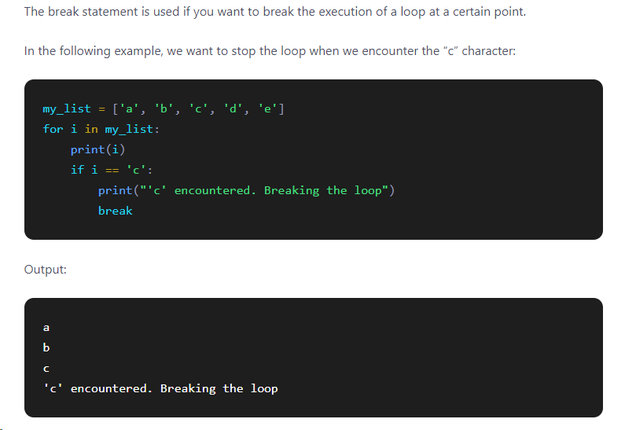
Loop manipulation using Break
The break statement allows you to prematurely exit from a loop, regardless of whether it is a for loop or a while loop.
When encountered, the break statement terminates the current loop iteration and transfers the program's control to the statement immediately following the loop.

Slide 24
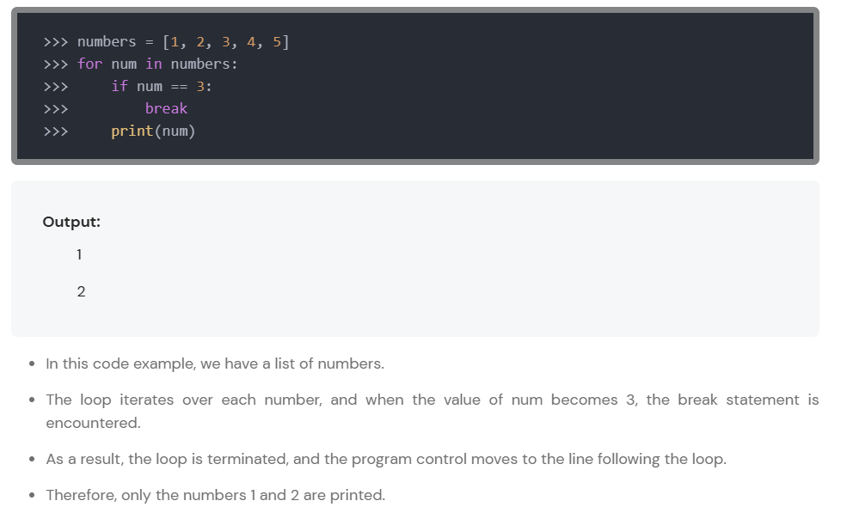

Slide 25
Loop manipulation using Continue
The continue statement allows you to skip the remaining statements within a loop iteration and move to the next iteration.
It is particularly useful when you want to exclude certain elements from processing within a loop.

Slide 26
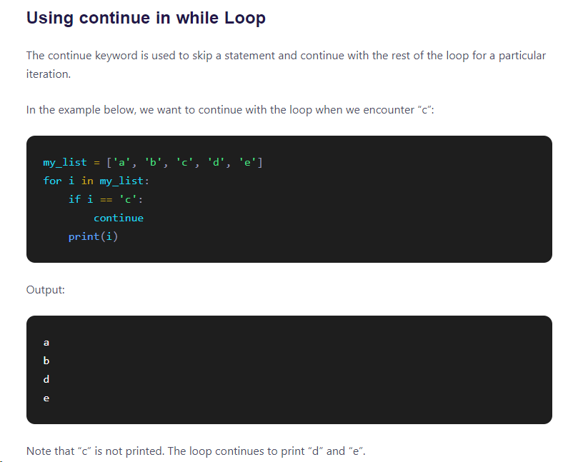

Slide 27
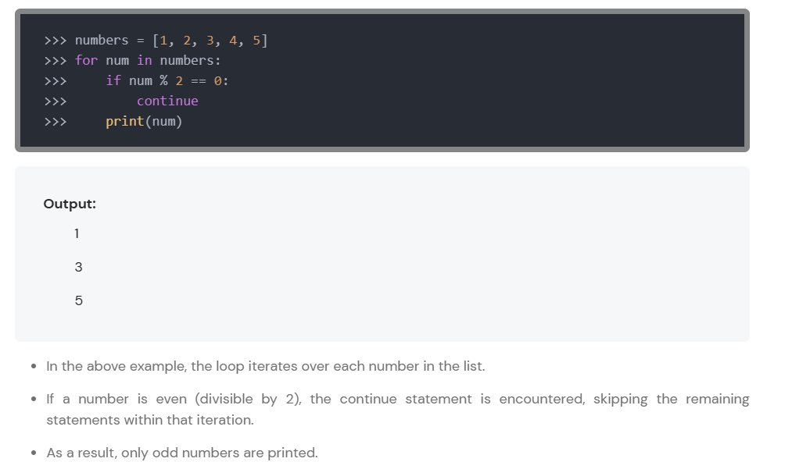

Slide 28
The Pass Statement
The pass statement is a placeholder statement that does nothing. It is used when you need a statement syntactically but don't want to perform any action.
The pass statement is often used as a placeholder while developing code, allowing you to leave functions or classes empty until you are ready to implement them.

Slide 29
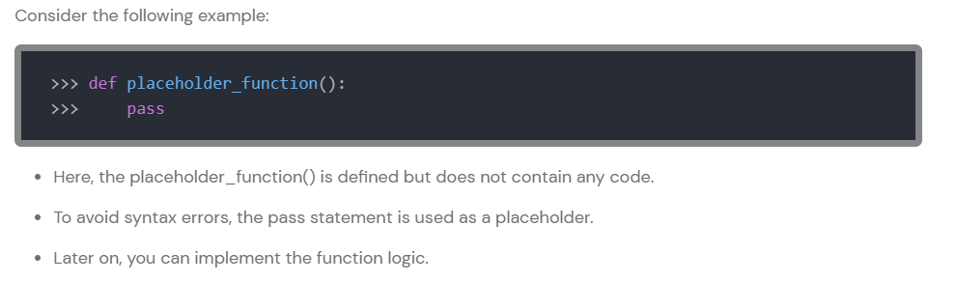

Slide 30

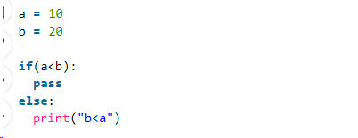
When the user does not know what code to write, So user simply places a pass at that line.
#Write a program to print only negative numbers
nums= [1,4,-3,2,-5,6,-8]
for i in nums:
if i>0:
pass
else:
print(i)

Slide 31
Tell the output
for i in range(3):
for j in range(4):
print("i= ", i, " j= ", j)

Slide 32
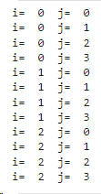

Slide 33
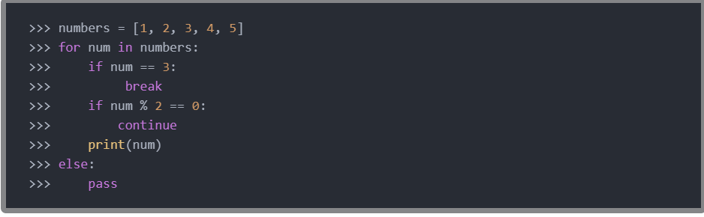
Combining the Statements
The break, continue, and pass statements can be combined to create complex control flows. By leveraging these statements effectively, you can customize the execution of loops and conditionals to meet specific requirements.

Slide 34
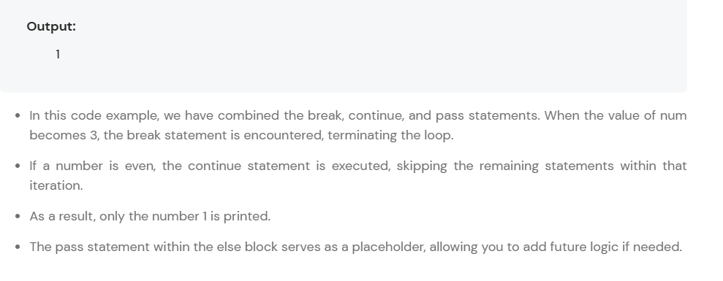

Slide 35
Try and except in python
The try except statement can handle exceptions. Exceptions may happen when you run a program.
Exceptions are errors that happen during execution of the program. Python won’t tell you about errors like syntax errors (grammar faults), instead it will abruptly stop.
An abrupt exit is bad for both the end user and developer.
Instead of an emergency halt, you can use a try except statement to properly deal with the problem.

Slide 36
The idea of the try-except block is this:
try: the code with the exception(s) to catch. If an exception is raised, it jumps straight into the except block.
except: this code is only executed if an exception occurred in the try block. The except block is required with a try block, even if it contains only the pass statement.
It may be combined with the else and finally keywords.
else: Code in the else block is only executed if no exceptions were raised in the try block.
finally: The code in the finally block is always executed, regardless of if a an exception was raised or not.

Slide 37
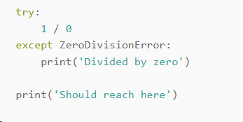
The try-except block can handle exceptions. This prevents abrupt exits of the program on error. In the example below we purposely raise an exception.
After the except block, the program continues. Without a try-except block, the last line wouldn’t be reached as the program would crash.

Slide 38
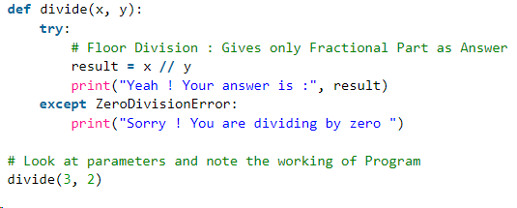
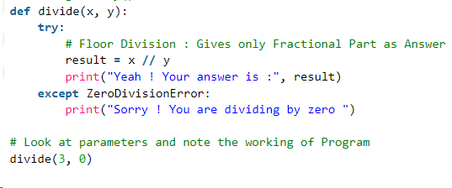
Output :
Yeah ! Your answer is : 1
Sorry ! You are dividing by zero

Slide 39
Else Clause
def ABC(a , b):
try:
c = ((a+b) // (a-b))
except ZeroDivisionError:
print ("a/b result in 0")
else:
print (c)
# Driver program to test above function
ABC(2.0, 3.0)
ABC(3.0, 3.0)
In Python, you can also use the else clause on the try-except block which must be present after all the except clauses. The code enters the else block only if the try clause does not raise an exception.

Slide 40
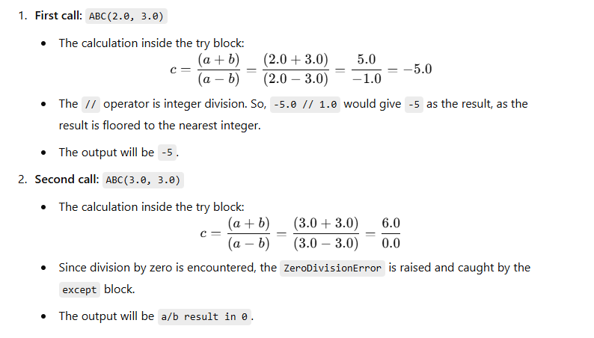
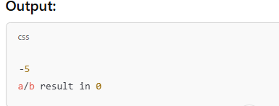

Slide 41
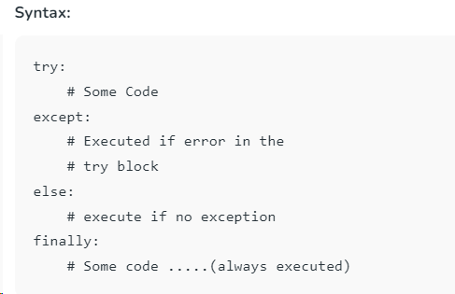
Finally Keyword in Python
Python provides a keyword finally, which is always executed after the try and except blocks. The final block always executes after the normal termination of the try block or after the try block terminates due to some exceptions.

Slide 42
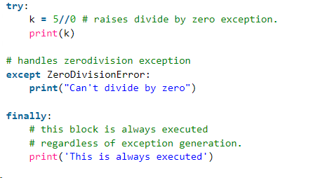

Slide 43
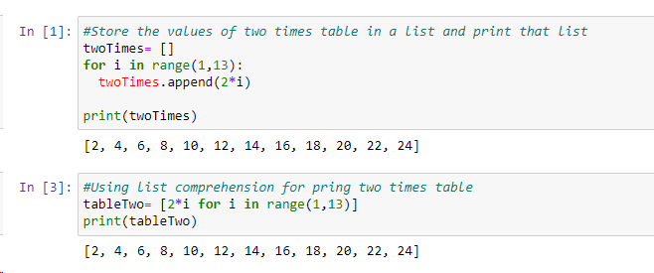
LIST COMPREHENSION
Syntax becomes shorter and elegant with list comprehension

Slide 44
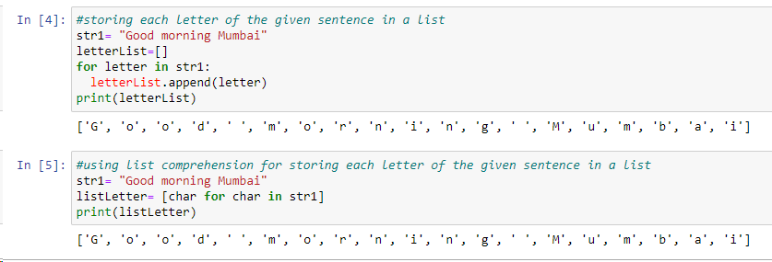

Slide 45
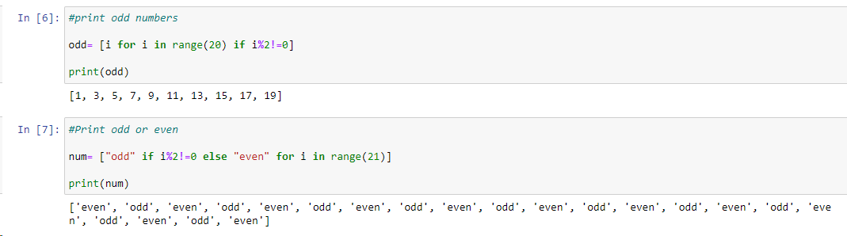
Using condition in list comprehension

Slide 46
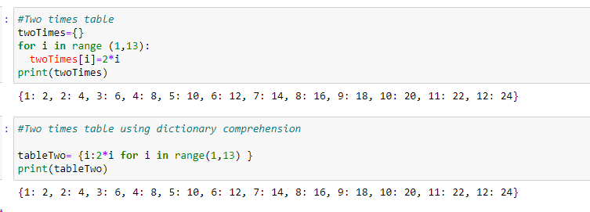
Dictionary comprehension

Slide 47
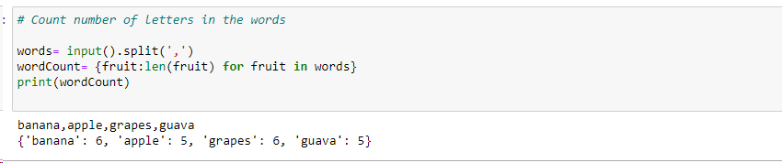

Slide 48
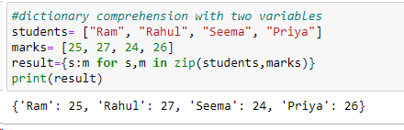

Slide 49
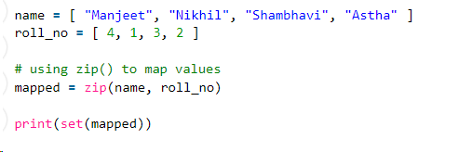
Zip function with lists
The zip() function is used to combine two or more lists (or any other iterables) into a single iterable, where elements from corresponding positions are paired together. The resulting iterable contains tuples, where the first element from each list is paired together, the second element from each list is paired together, and so on.

Slide 50
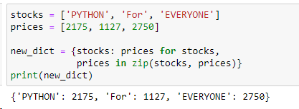
Python zip() with Dictionary
The zip() function in Python is used to combine two or more iterable dictionaries into a single iterable, where corresponding elements from the input iterable are paired together as tuples. When using zip() with dictionaries, it pairs the keys and values of the dictionaries based on their position in the dictionary..

